Slide 1
TOP 250 MOVIES IMDB RATING
TEAM MEMBERS OF PEGASUS
RAJESH KANNAN M 212221230081
KRISHNA PRAKAASH D M 212221230052
VENKATESH E 212221230119
AKASH KUMAR 212221040011

Slide 2
ABOUT THE PROJECT
ANALYSING THE TOP 250 MOVIES IMDB RATING
THE INTERNET MOVIE DATABASE (IMDB) IS AN ONLINE DATABASE CONTAINING INFORMATION AND STATISTICS ABOUT MOVIES,TV SHOWS AS WELL AS ACTORS AND OTHER FILM INDUSTRY PROFESSIONALS.
USING BARPLOT , HISTPLOT, DISTPLOT, LINE PLOT, COUNT PLOT WE DETERMINE THE BEST MOVIE.

Slide 3
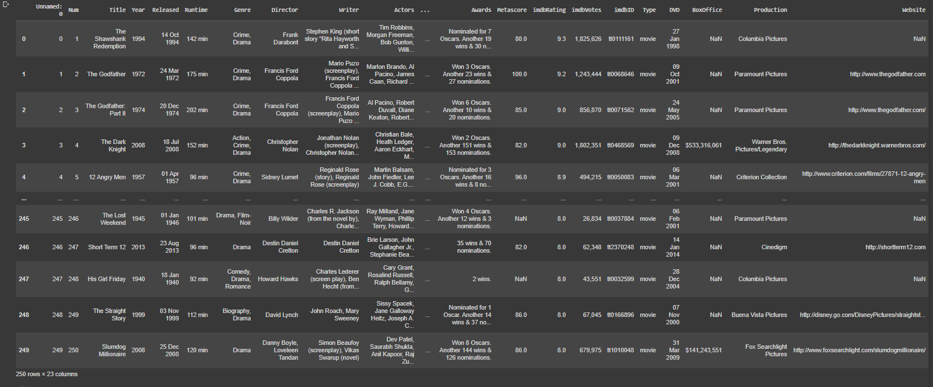
DATASET USED
THE DATA REPRESENT TOP 250 IMDB RATED MOVIES
Notes:
JBJJB

Slide 4
OPERATION IMPLEMENTED
From Pandas library :
-head(), .tail(), .info() , .describe() , .shape() , .fillna() , .mode() , .columns , .isnull().sum ,
.duplicated() , .value_counts() , .nunique()
From seaborn with matplotlib.pyplot :
Matplotlib:
-.figure() , .xticks() , .show() , .title() ,
Seaborn:
-.countplot() , .violinplot() , .lineplot() ,Boxplot , Distplot , Histplot , Pointplot

Slide 5
CODING WITH
CORRESPONDING OUTPUT
(INCLUDE GITHUB LINK)
GITHUB LINK :
https://github.com/Rajeshkannan-Muthukumar/DS_Mini_Project

Slide 6
INFERENCE
WARNER BROTHERS PICTURES IS THE MOST POPULAR PRODUCTION HOUSE.
LAWRENCE OF ARABIA AND CASABLANCA HAVE THE HIGHEST METASCORE.
DRAMA IS THE MOST POPULAR GENRE.
IN THE TOP SELLING CATEGORY ,THE MATRIX MOVIE GOT 1.3M VOTES AMONG ALL THE MOVIES .
LEONARDO DICAPRIO IS THE MOST POPULAR ACTOR .
ALFRED HITCH IS MOST POPULAR DIRECTOR.
DRAMA IS THE MOST POPULAR GENRE.
SCIENTIFIC FICTION IS THE LEAST POPULAR GENRE.
IN 2012,THE IMDB RECEIVED THE HIGHEST NUMBER OF VOTES

Slide 7
THANK YOU !!

